Slide 1
Article propose

Slide 2
novel online approach of multi-modal relational graph network to dynamically integrate visual and kinematics information through interactive message propagation in the latent feature space.

Slide 3
PERIOR WORKS

Slide 4
NN based Kinematic data:
hidden Markov models
linear classifiers with hand-crafted metrics
long short-term memory (LSTM)
multi-task recurrent neural network
multi-scale recurrent network (offline)
NN based Visual data:
deep convolutional neural networks
Temporal convolutional network (TCN)
recurrent convolutional network
3D convolutional network
Symmetric dilated convolution
NN based Kinematic and visual data
Joint prediction of motion and surgical state in robot assisted surgery

Slide 5
Experiments

Slide 6
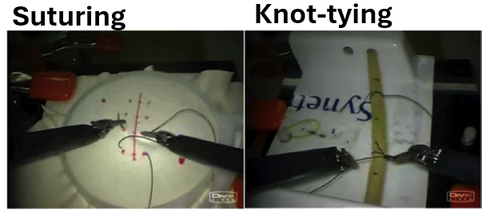
Experiment 1
Train and Test dataset : JIGSAWS (suturing and knot-typing)

Slide 7
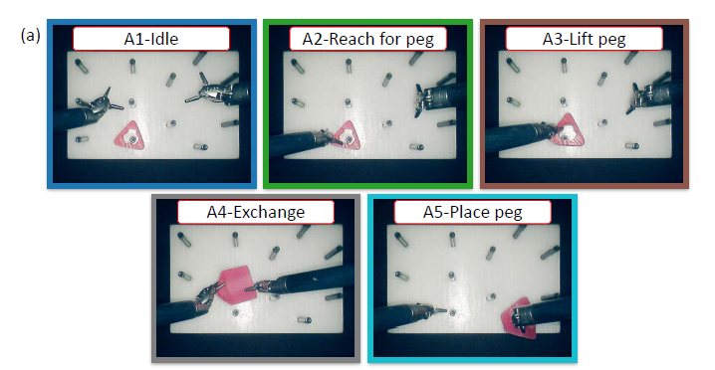
Experiment 2
In-house dVRK datasets from two centers: CUHK , JHU
Peg transfer task, a standard exercise in laparoscopic surgical training
Gesture:

Slide 8
MODEL

Slide 9
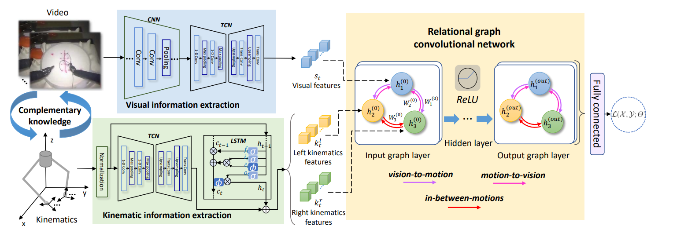

Slide 10
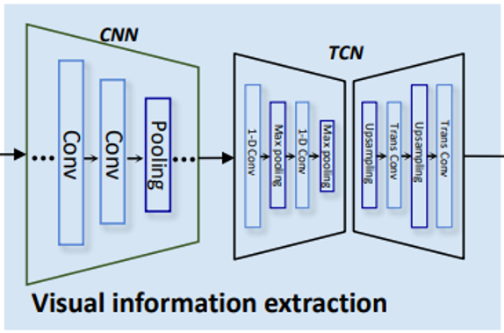
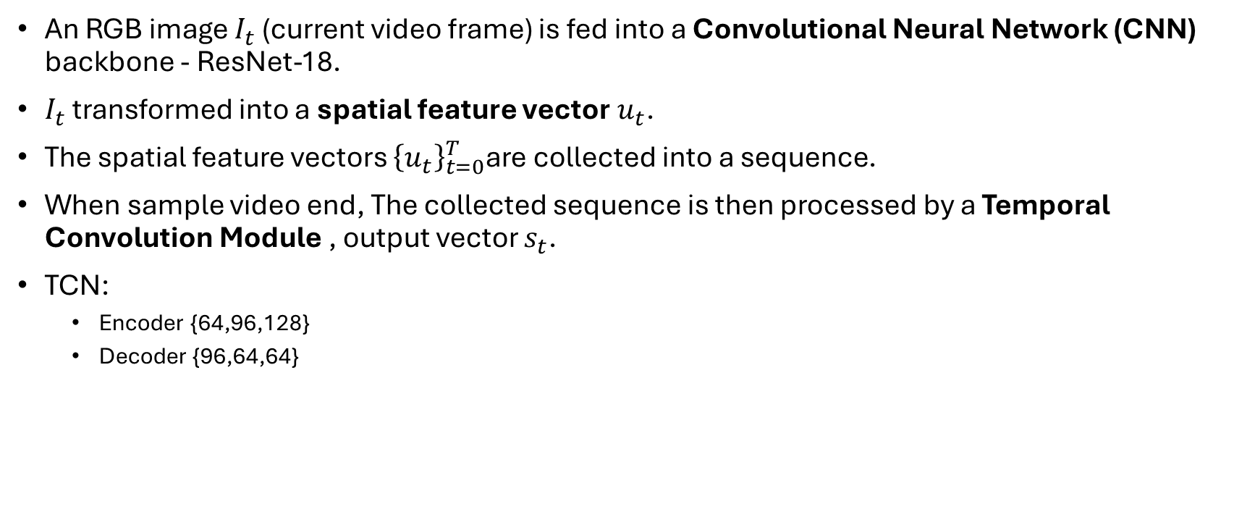
Visual Information Extraction Module
An RGB image $I_{t}$​ (current video frame) is fed into a Convolutional Neural Network (CNN) backbone - ResNet-18.
$I_{t}$​ transformed into a spatial feature vector$u_{t}$.
The spatial feature vectors ${\left\{u_{t}\right\}}_{t=0}^{T}$are collected into a sequence.
When sample video end, The collected sequence is then processed by a Temporal Convolution Module , output vector $s_{t}$.
TCN:
Encoder {64,96,128}
Decoder {96,64,64}

Slide 11
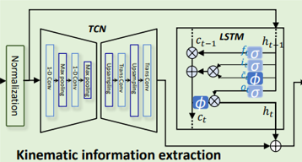
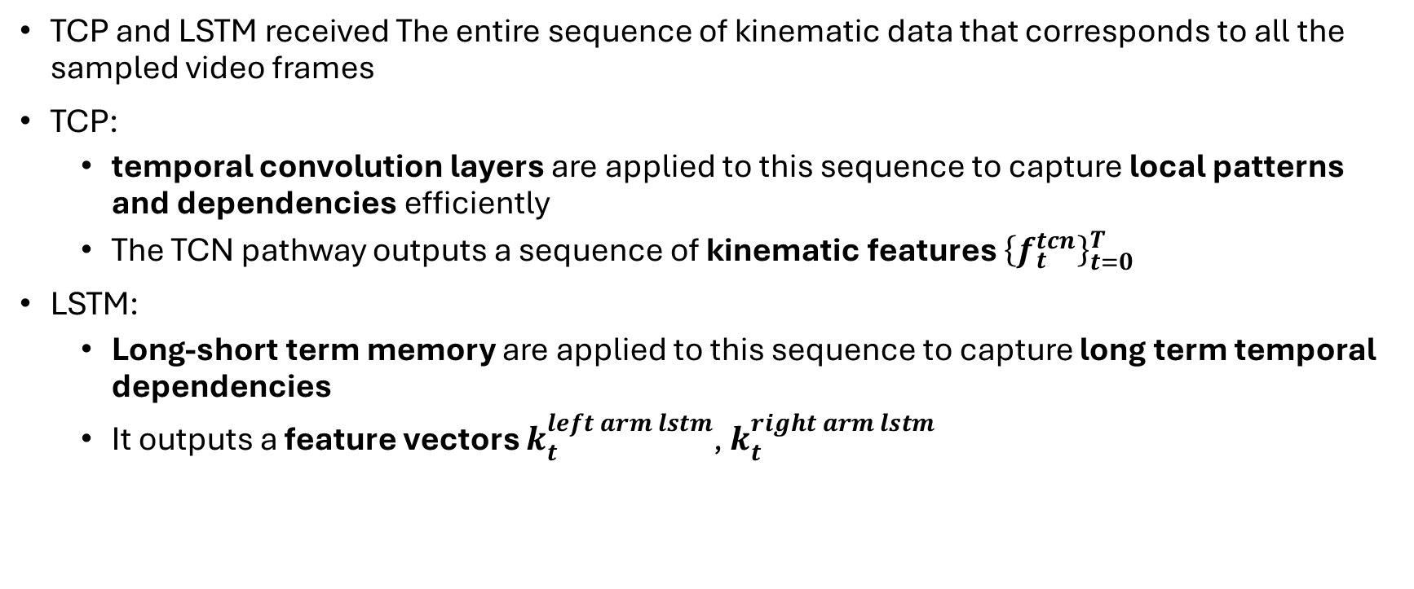
Kinematic Information Extraction Module
TCP and LSTM received The entire sequence of kinematic data that corresponds to all the sampled video frames
TCP:
temporal convolution layers are applied to this sequence to capture local patterns and dependencies efficiently
The TCN pathway outputs a sequence of kinematic features ${\left\{f_{t}^{tcn}\right\}}_{t=0}^{T}$
LSTM:
Long-short term memory are applied to this sequence to capture long term temporal dependencies
It outputs a feature vectors $k_{t}^{left arm lstm}$, $k_{t}^{right arm lstm}$

Slide 12

Graph convolution network - KV FUSION
Nodes:
Left kinematics $K_{t}^{l}$
Right kinematics $K_{t}^{r}$
Video $s_{t}$

Slide 13
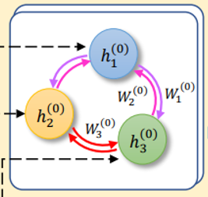

Define adjacency matrix A
$\left|R\right|=3; 3 types of relationships$
“Vision to motion”
“Motion to vision”
“Hands interaction”

Slide 14
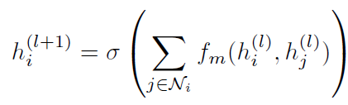
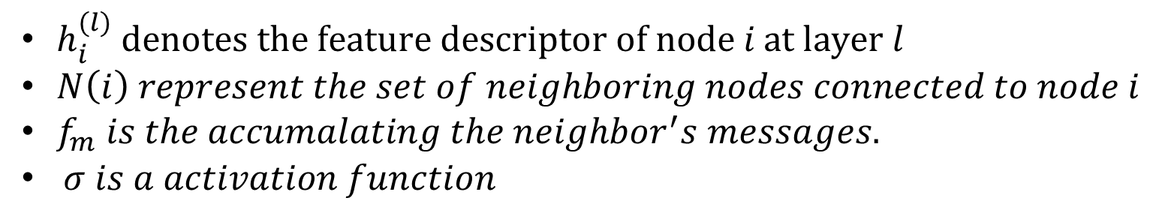
Aggregation function:
$h_{i}^{(l)} \text{denotes} \text{the} \text{feature} \text{descriptor} \text{of} \text{node} i \text{at} \text{layer} l$
$N\left(i\right) represent the set of neighboring nodes connected to node i$
$f_{m} is the accumalating the neighbor^{′}s messages.$
$σ is a activation function$

Slide 15

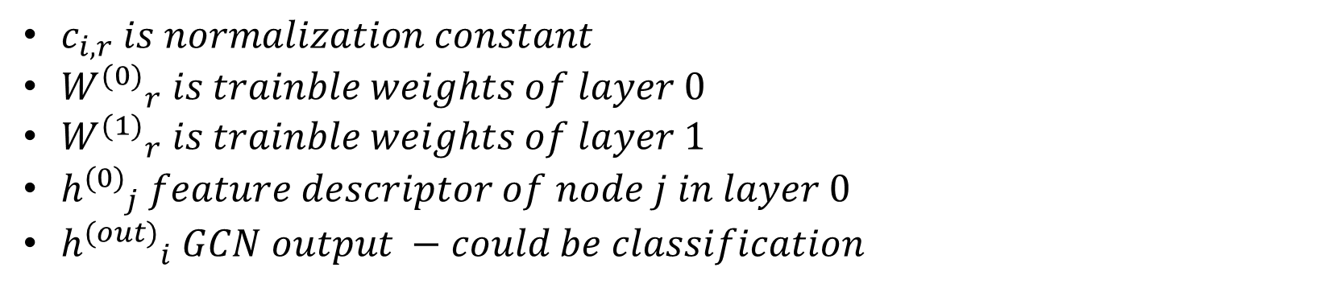
GCN layer output
$c_{i,r} is normalization constant$
${W^{(0)}}_{r} is trainble weights of layer 0$
${W^{(1)}}_{r} is trainble weights of layer 1$
${h^{(0)}}_{j} feature descriptor of node j in layer 0$
${h^{(out)}}_{i} GCN output −could be classification$

Slide 16


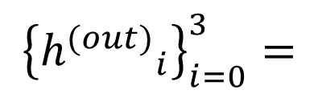
Classification prediction ${\hat{p}}_{t}$
$${\left\{{h^{(out)}}_{i}\right\}}_{i=0}^{3}=$$

Slide 17

Loss function

Slide 18
Experiments Results

Slide 19
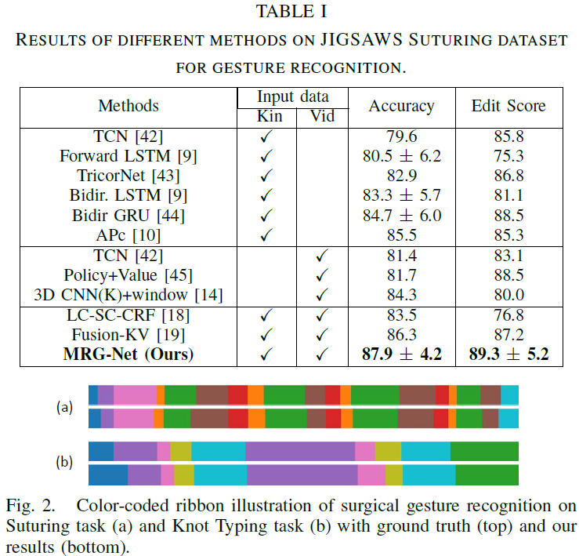
Experiment 1

Slide 20
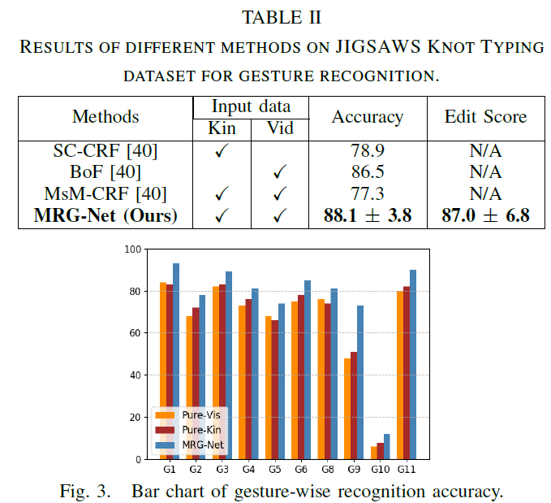

Slide 21
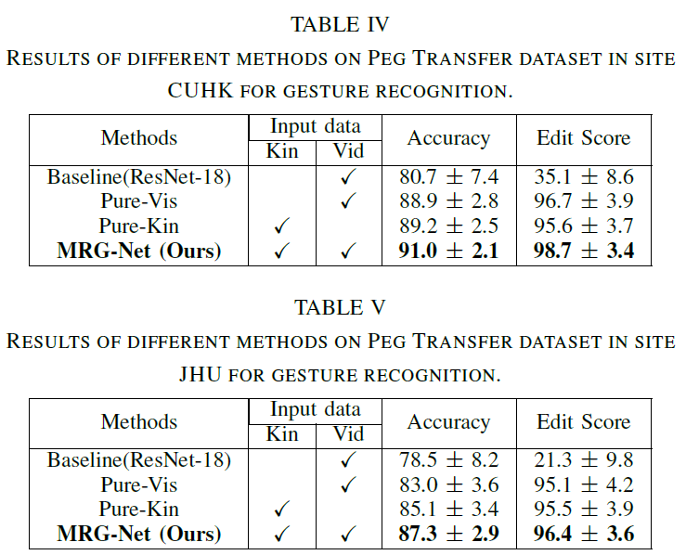
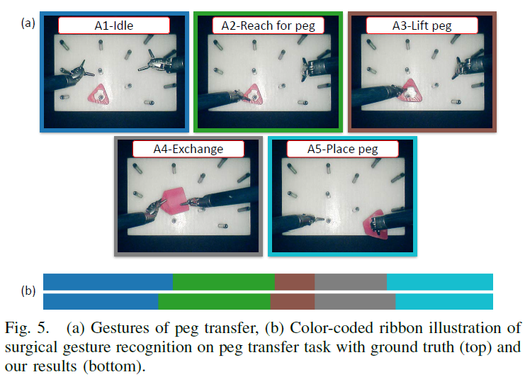
Experiment 2

